Slide 1
Walmart Midterm Project
Case Name
Presented by Case Crushers
–AJ Amos
-Eli Schoeniger
-Sophie Li

Slide 2
Agenda
The Mess
1
The Pipeline
2
Findings
3
Recommendation
4
What Broke
5

Slide 3
The Mess
60 ways to write
12 stores
5 timestamp formats
4 SKUs for one Pop-Tart
The same store showed up under many different IDs, so sales from one store looked like they came from several.
– E.g., FL-412, fl_412, FL412, FL-412…
– 4,345 rows needed a fixed store ID
– Without it, sales couldn’t join to store locations
Dates and times were written in five different ways, and some rows had no time at all.
– E.g., 2024-09-25 08:15 vs 09/25/2024 20:08…
– A basic date parse read only about 10% of rows
– 886 rows had no timestamp
Strawberry Pop-Tarts was recorded under four product codes, which hid how much it really sold.
– E.g., PT-12, SKU#459812, POPTART-STRAW, PT_STRAWBERRY
– The split up shows the best Pop-Tarts SKU sold only about 103 a day, rank #3 - underestimated!
– After combination Pop-Tarts sold about 377 a day, rank #1!
Notes:
Eli (1min~):
So before we could answer any of the five questions, we had to deal with the data itself, and honestly, it was a mess. Nothing agreed with anything else.
First, the stores. There are only 12 stores, but their IDs were written about 60 different ways, things like FL-412, fl underscore 412, no dash at all. So one store looked like several, and over 4,000 rows wouldn’t even match up with the store file until we fixed them.
Second, the timestamps came in five different formats. If you just run a normal date parse on it, it only reads about 10% of the rows, so most of the sales would’ve just quietly disappeared from our charts. And on top of that, 886 rows didn’t have a time at all.
And third, the one that ended up mattering most: Strawberry Pop-Tarts was recorded under four different product codes. Looking at them separately, the best one only sold about 103 a day. Put them together, and it’s actually the number one storm product. We’ll come back to that in the findings.
There was more, like duplicate rows and prices stored as text, but these three were the big ones. So next, I’ll walk you through how we cleaned it all up.

Slide 4
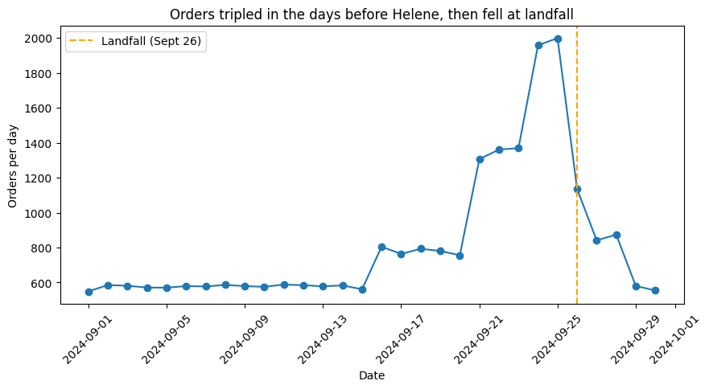
The Pipeline
Clean
– 60 store IDs → 12 stores, 37 categories → 10
– 45 SKUs → 20 real products, all 5 date formats parsed
– 22 cleaning steps logged, each with a row count
Flag & Keep
Join Weather
– Only 30 exact duplicates removed (25,562 → 25,532)
– 884 rows with no timestamp kept, left out of time charts
– 130 negative quantities kept as returns, left out of demand
– Open-Meteo API weather for all 12 store locations
– Joined on date + store location
– 3,600 rows before the join, 3,600 after - none lost
Notes:
Eli + AJ + Sophie (1min~):
Eli: So once we knew how messy the data was, here’s how we cleaned it up.
First, for cleaning, we took the 60 different store IDs down to the real 12 stores, the 37 category spellings down to 10, and the 45 product codes down to 20 real products. We also got all 5 date formats reading correctly. And every cleaning step went into a decision log with how many rows it changed, 22 steps in total, so anyone can trace exactly what we did.
AJ: Then for the weather, we pulled real daily weather from the Open-Meteo API for each of our 12 store locations, and joined it to the sales by date and store. We checked the row count before and after. We got 3,600 rows in and 3,600 out, so nothing got lost in the join.
Eli: The biggest decision we made was to flag and keep messy rows instead of deleting them. The only rows we actually removed were 30 exact duplicates. Rows with no timestamp, or with negative quantities that look like returns, we kept but marked. That way each question could decide what to leave out. The time charts skip rows with no date, and the demand numbers skip returns, but we never threw anything away we might need later.
Sophie: And this chart on the left is how we knew the pipeline worked. It’s daily orders after cleaning. If something were broken, you’d see a day at zero or a random spike. Instead, it’s flat for two weeks, climbs before the storm, peaks right before landfall, and drops off. That’s exactly the Helene pattern, so we felt confident moving on to the findings.

Slide 5
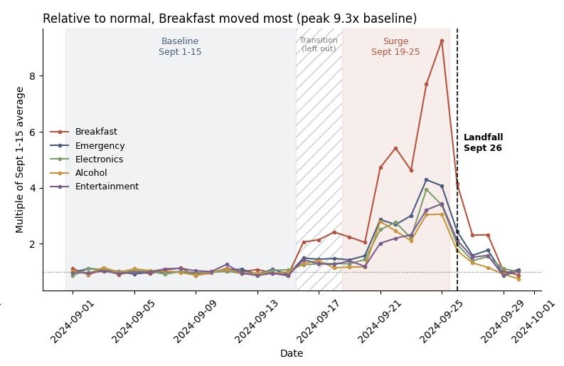
Q1: Demand Surge
Demand Surge
The Pop-Tarts Effect
Weather Correlation
Store-level Patterns
Signal vs. Artifact
Breakfast Surged 414% Before Landfall
– We compared normal days (Sept 1–15) with the 7 days before landfall (Sept 19–25). We left out Sept 16–18 because sales were already starting to rise.
– Breakfast had the biggest jump, from 73 to 377 units a day (+414%). At its peak on Sept 25, it sold 9.3 times its normal amount.
– Emergency supplies (+184%) and Electronics (+150%) came next. Emergency was the biggest category overall, selling about 650 more units a day.
– Every top category peaked on Sept 24–25 and dropped once the storm hit.
Notes:
Eli (35 sec~): For question 1, we compared normal days Sept 1 to 15 with the 7 days before landfall Sept 19 to 25. We left out the 16th to 18th because sales were already starting to climb. We found out that breakfast had the biggest jump by far, from 73 units a day to 377, that’s up 414%. Emergency supplies were next at 184%. Every category peaked on the 24th or 25th, right before landfall, and dropped once the storm hit.

Slide 6
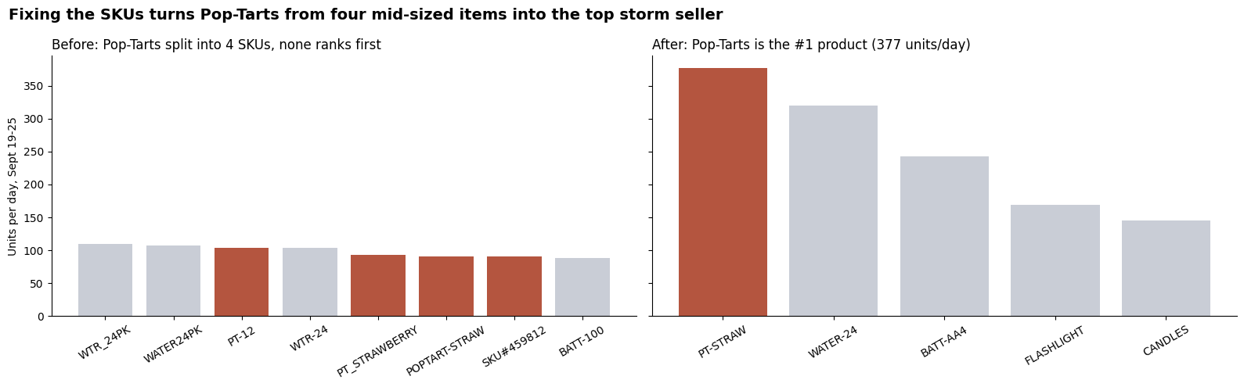
Demand Surge
The Pop-Tarts Effect
Weather Correlation
Store-level Patterns
Signal vs. Artifact
Q2: The Pop-Tarts Effect
Before: Split Into 4 SKUs
After: Combined Into One Product
– The best Pop-Tarts code sold about 103 a day, ranked #3 behind water
– Looks like an ordinary item, so it would be under-ordered
– 377 a day in the storm week, the #1 storm product
– Ahead of bottled water (320 a day)
Notes:
Eli (35 sec~): Now we move on to the second question. On the left is what the data looks like before we fixed them. Pop-Tarts is split into four separate codes, those are the red bars. The best one only sells about 103 a day, and it comes in third, behind two water codes. So it just looks like a normal item.
On the right, once we combine them into one product, Pop-Tarts sells 377 a day during the storm week. That makes it the number one storm product, even ahead of bottled water.
And we double-checked that combining didn’t lose anything. We had the same 25,532 sales and 49,343 units before and after.
So if Walmart only looked at the raw data, they’d under-order the one item people wanted most.

Slide 7
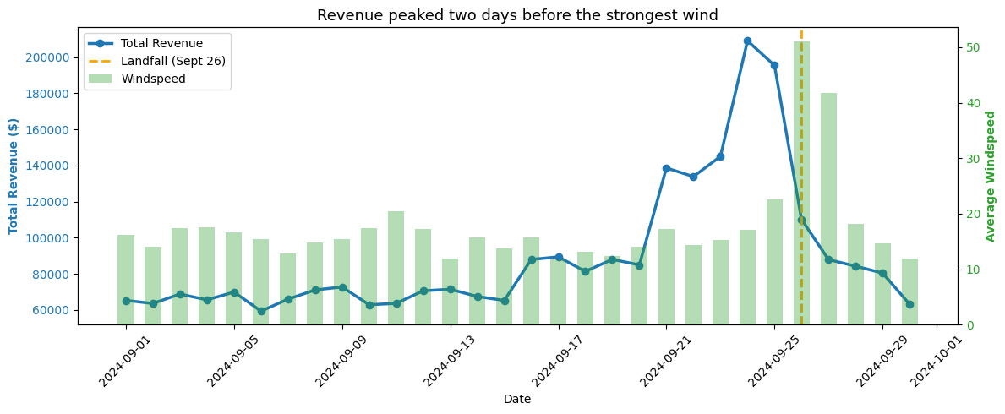
Demand Surge
The Pop-Tarts Effect
Weather Correlation
Store-level Patterns
Signal vs. Artifact
Q3: Weather Correlation
People Bought About 2 Days Before
the Worst Weather
– We pulled real daily weather from the Open-Meteo API for all 12 store locations and joined it to sales by date and store.
– Sales peaked on Sept 24–25, but the strongest wind and heaviest rain both came on Sept 26, the day of landfall.
– Sales and wind barely line up on the same day, but match closely when we compare sales with the wind two days later.
– This means shoppers reacted to the forecast, not the weather itself. It’s based on 30 days and one storm, so it shows a pattern, not proof.
Notes:
AJ (35 sec~): For weather, we pulled real daily weather for all 12 of our store locations and matched it to sales by date and store.
The main thing we found is that people didn’t shop during the storm, they shopped before it. On the chart, the blue line is revenue, and it peaks on the 24th and 25th. The green bars are wind, and the strongest wind doesn’t come until the 26th, landfall day. Rain peaked that same day too.
If you compare sales and wind on the same day, they barely line up. But compare sales to the wind two days later, and they match really closely. So shoppers were reacting to the forecast, not to the weather outside.
We also saw rainy days earlier in September that didn’t change sales at all, which backs that up. One caveat we had is that this is 30 days and one storm, so it’s a pattern, not proof.

Slide 8
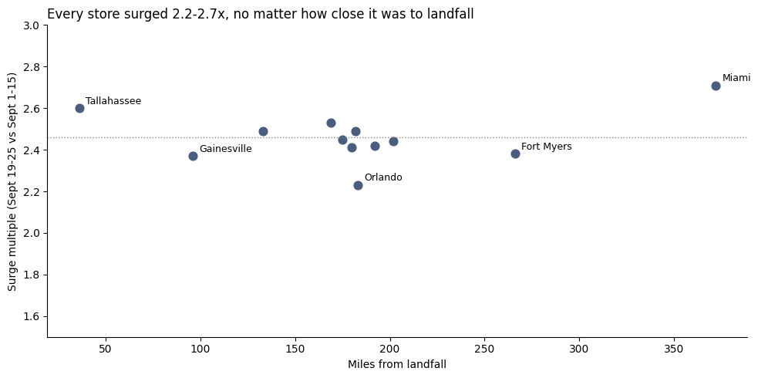
Demand Surge
The Pop-Tarts Effect
Weather Correlation
Store-level Patterns
Signal vs. Artifact
Q4: Store-level Geographic Patterns
Every Store Surged 2.2–2.7x,
Near or Far from the Storm
– All 12 stores sold between 2.2 and 2.7 times their normal amount, and all of them surged in the same week.
– Miami, the farthest store from landfall (372 miles), had the biggest surge at 2.71x. Orlando had the smallest at 2.23x.
– Distance from landfall barely made a difference (correlation of 0.23), and with only 12 stores, that could easily be noise.
– Shoppers across Florida reacted to the statewide forecast, not to how close they were to the storm.
Notes:
AJ (35 sec~): For stores, we expected the ones closest to the storm to surge the most, but that’s not what we found.
Each dot on the chart is one store. Left to right is how far it is from where Helene made landfall, and higher up means a bigger surge. All 12 stores sold between 2.2 and 2.7 times their normal amount, and they all surged in the same week.
Miami, way over on the right, is the farthest store from landfall, about 372 miles, and it actually had the biggest surge at 2.71x. Orlando had the smallest at 2.23x.
So distance barely made a difference. The correlation is only 0.23, and with just 12 stores, that could easily be noise. Same as we talked about in last slide, it looks like shoppers across Florida were all reacting to the same statewide forecast, not to how close they were to the storm.

Slide 9
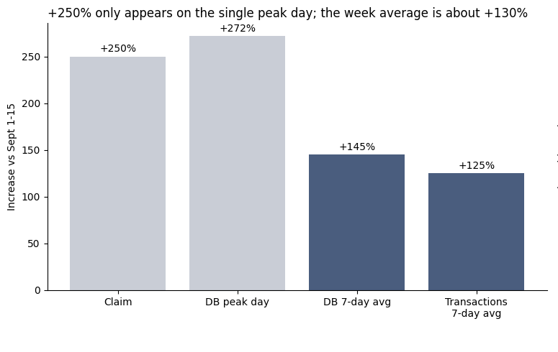
Demand Surge
The Pop-Tarts Effect
Weather Correlation
Store-level Patterns
Signal vs. Artifact
Q5: Signal vs. Artifact
The Surge Is Real, but +250% Overstates It
– The +250% number only shows up if you compare the single busiest day (Sept 24) to a normal day.
– Over the full storm week, the increase was about +130% (+125% in the transactions, +145% in the database), mostly Monopoly (+160%).
– The surge itself is real: the sales database and the transactions both show it, and only 10 of 360 database rows had errors.
– Board game stock dropped from about 134 to 33 units per store right when sales went up, which only happens with real buying.
Notes:
Sophie (35 sec~): For the last question, we were told board games jumped 250% before the storm, and we wanted to know if that was real or just a data problem.
The answer is, the surge is real, but 250% makes it look bigger than it was. On the chart at the left, the gray bars are the big numbers, and you only get them by comparing the single busiest day to a normal day. The blue bars are the full storm week, and that’s about 130%, with Monopoly driving most of it.
We’re confident it’s real for a few reasons. Both of our data sources show it, there were barely any errors in the data, and board game stock dropped from about 134 to 33 per store right when sales went up. That only happens when people are actually buying.
So yes, Walmart should stock more board games, just not 3.5 times as many.

Slide 10
Restock a Week Early
Restock Every Store
Stock Pop-Tarts First
Split Supply: JAX + Miami
Recommendation
Sales started rising about 10 days before the storm and peaked on Sept 24–25, just 1–2 days before landfall. Stock that arrives on landfall day is mostly too late, so start restocking a week ahead.
All 12 stores surged 2.2–2.7x in the same week, no matter how close they were to the storm. Miami, the farthest store, surged the most, so send extra stock statewide, not just to stores on the storm’s path.
Breakfast rose 414% and Emergency 184%. Pop-Tarts was the #1 storm product once its 4 SKUs were combined, so track it as one item. For Board games, stock more, but plan for about +130%, not +250%.
Jacksonville is closest to 9 of the 12 stores and would carry about 74% of the extra demand. Moving Tampa, St. Pete, Lakeland and Kissimmee to the Miami center balances the load, with Atlanta as backup.
Notes:
Sophie (1min~): So here’s what we’d actually tell Walmart.
First, they should restock a week early. Sales started climbing about ten days out and peaked a day or two before the storm hit, so anything that arrives on landfall day is basically too late.
Second, they should restock every store, not just the ones in the storm’s path. All 12 stores surged in the same week, and Miami, the farthest one, actually surged the most.
Third, they should consider to stock Pop-Tarts first. It was the number one storm product, but only once you combine its four product codes, so Walmart should track it as one item. Water, batteries and flashlights come next. For board games, stock a little more, but plan for about 130%, not 250%.
And finally, they should split the supply. If every store just used its closest distribution center, Jacksonville would handle about three-quarters of the extra demand by itself. So we’d move Tampa, St. Pete, Lakeland and Kissimmee over to Miami to balance the load.
All of this comes from one storm, so the exact numbers might not repeat, but it gives Walmart a clear plan to start from.

Slide 11




– The Weather API Timed Out:
– While rerunning the notebook, the Open-Meteo API timed out. Our backup kicked in, but it only had 30 rows of Orlando weather instead of 3,600 rows for all 12 stores, so every chart after it broke.
– What We Learned:
– A backup is only useful if it matches the real data. Next time, we’d save the full store-level weather to a file once and reuse it, and give the API more time before retrying.
What Broke
Notes:
Sophie (30 sec~): One thing that broke on us was the weather API. While we were rerunning the notebook, the API timed out. Our code did catch it and switched to a backup, which was good, but the backup only had 30 rows of weather for Orlando, not the 3,600 rows for all 12 stores. So every chart after that point broke.
What we learned is that a backup only helps if it looks like the real data. Next time, we’d save the full store-level weather to a file the first time it works, and just reuse that, so one slow API call can’t break the whole notebook.

Slide 12
Thank you!

